Slide 1
Small Intestinal Pathology
Prof. J. Hewavisenthi
Professor of Pathology
Department of Pathology

Slide 2
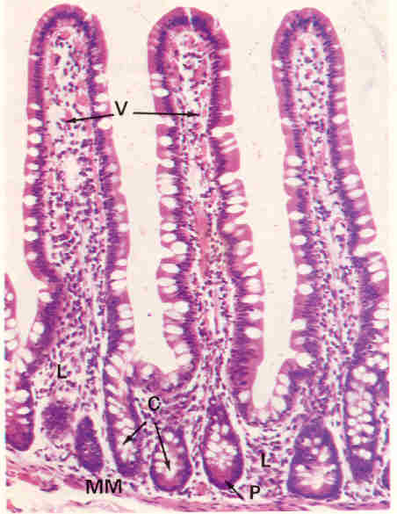
Small Intestines - Histology
Villi
Crypts Villix3>Depth of the crypts.
Lining cells - Paneth, Goblet, Endocrine and Undifferentiated cells.
Lamina propria.
Muscularis mucosa.
Submucosa - duodenum contains Brunner’s glands
Muscularis propria.
Serosa.

Slide 3
Congenital Abnormalities:
Atresia
Stenosis
Diverticula -
  Meckels’ (persistence of vestigeal remnant of the omphalomesentric duct): Usually within 12” of the IC valve.
    Complication - inflammation Obstruction Peptic ulcer.
Heterotopic pancreatic nests.

Slide 4
Malabsorption Syndrome.
Definition - Characterized by faecal excretion of fat and variable malabsorption of fat soluble Vit, Proteins, CHO, mineral and water.
Digestion or absorption of one nutrient may be impaired.
or:
Many or all nutrients impaired in transport and absorptive disorders.
  Maldigestion – impaired breakdown of nutrients to absorbable split products
  Malabsorption – defective mucosal uptake and transport of adequately digested nutrients.

Slide 5
Malabsorption Syndrome - Clinical features
LOW, LOA, Abd: distension, Mm wasting, Borborygmi
Passage of Bulky frothy Greasy stools - Steatorrhoea
Protein deficiency
Avitaminosis.- Vit A, D, K.
Megaloblastic anaemia - Vit B12

Slide 6
Pathophysiology
Understanding of the physiology of nutrient digestion and absorption in the gut essential.
Malabsorption is the result of the disturbance of at least one of the four phases of nutrient absorption
  Intraluminal digestion
  Terminal digestion
  Transepithelial transport
  Lymphatic transport

Slide 7
Causes of Malabsorption
Defective intraluminal and transepithelial digestion
  1.Pancreatic insufficiency.
  2. Bacterial overgrowth.
  3. Intestinal resection.
Inadequate surface / Mucosal abnormality (Transepithelial digestion) -
  Primary mucosal disease - 1. Disaccaridase def 2. Abetalipoproteinaemia
  3. Vit B12 malabsorption

Slide 8
Causes - contd
  Small bowel disease - 1. Coeliac disease. 2. Whipple’s disease. 3. Crohn’s disease - may be multifactorial
  4. Eosinophilic gastroenteritis.
  Lymphatic obstruction - 1. Lymphoma. 2. TB 3. Lymphangiectasia.

Slide 9
Causes cont…….
Multiple defects -
  1.Subtotal gastrectomy.
  2. Ileal resection/by pass.
  3. Radiation enteritis.
Unexplained -
  1.Hypogammaglobulinaemia.
  2. Carcinoid,
  3. DM.
  4. Endocrine causes. - Hyper and Hypothyroidism, Hypoadrenocortism and Hypoparathyroidism.

Slide 10
Causes
Infective -
  1.Tropical sprue.
  2. Infective enteritis.
  3. Parasitoses.
Drugs -
  1.Cholestyramine
  2. Neomycin.
  3. PAS

Slide 11
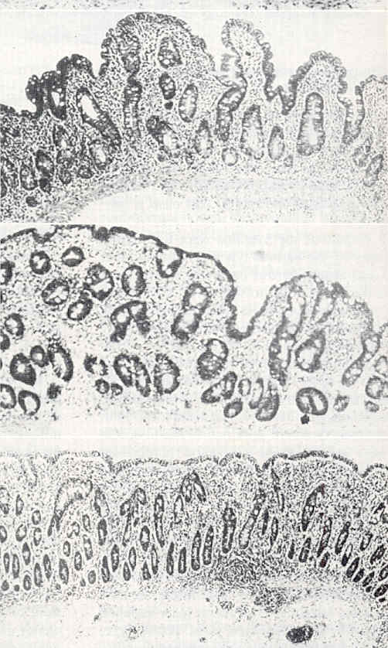
Partial villous atrophy
Subtotal villous atrophy
Total villous atrophy

Slide 12
Disaccharidase deficiency
May be familial / Acquired (following infective colitis)
Infants develop explosive watery diarrhoea with abdominal distension following milk feeds.
Investigation - ‘H’ breath test.

Slide 13
Coeliac disease / Gluten sensitive enteropathy
Female more affected than males.
Genetic predisposition, HLA phenotype in 60 -70% - HLA B8, DR7, DR3
Sensitive to food containing wheat, Barley, Rye (Gluten)
Microscopy -
  Subtotal villous atrophy
  Crypts elongated, hyperplastic tortuous.
  Inflammation within the lamina propria.
  Changes more marked in the proximal SI

Slide 14
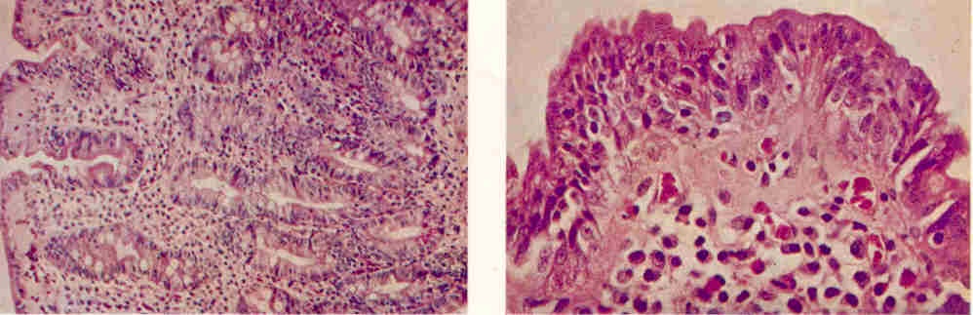
Coeliac disease – idiopathic steatotorrhoea

Slide 15
Tropical Sprue
Similar to Coeliac disease. But occuring in those visiting tropical climates.
Aetiology - ? E coli
Benefits from long term antibiotics
Microscopy - similar to Coeliac disease
But differs - More in the distal small bowel. Larger number of Lymphocytes and eosinophils within the lamina propria.

Slide 16
Whipple’s disease
Multisystem disorder
Infective agent - Trophorrhyma whippeli
Male preponderance in the 4th - 5th decade.
Macroscopy - Shaggy ‘bear skin’ appearance.
Microscopy - Macrophages laden with PAS positive granules within the lamina propria. Dilatation of lymphatic leading to fatty cysts.

Slide 17
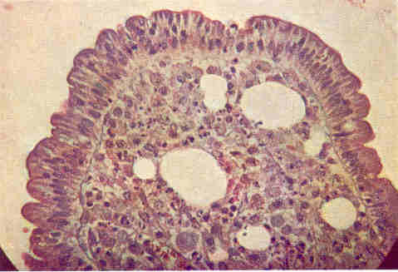
Whipple’s disease

Slide 18
Abetalipoproteinaemia
AR inheritance
Inborn error of lipoprotein metabolism - TGL are deposited in the mucosa causing vacuolation.
Failure to absorb certain fatty acids leads to defective red cell membranes - ‘Burr cells”

Slide 19
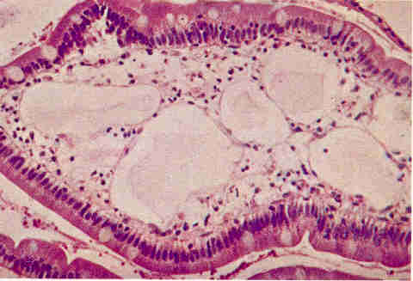
Intestinal lymphagiectasia

Slide 20
Bacterial overgrowth Syndromes
Pathologic colonization of the jejunal lumen by an abnormally large population of aerobic and anaerobic organisms. Qualitatively similar to those in the LI.
Mechanisms of control of organisms in the SI
  Continuous peristaltic activity.
  Gastric acidity - lower pH in the proximal SI.
  Presence of IgA in the bowel lumen.

Slide 21
Bacterial overgrowth Syndromes
Causes -
  lesions that predispose to luminal stasis - fistula, strictures, diverticula, blind loops, pouches
  Immune deficiency
  Hypo / achlorhydric states.
  Segments of denervated bowel

Slide 22
Bacterial overgrowth Syndromes
Mechanisms of malabsorption
  Increased bacterial load competing for nutrients
  Deconjugation of bile salts.
  Inactivation of lipases.
  Mucosal damage by bacterial proteases.

Slide 23
Appendicular pathology

Slide 24
Appendix - Acute appendicitis
Disease of the west (diet related )
Young males.
Aetiology –
  Obstructive (faecolith, Lymphoid hyperplasia)
  Non obstructive - Generalized infection
Clinical features - Colicky, sub -umbilical pain, RIF pain, fever, vomiting, leukopaenia.

Slide 25
Acute appendicitis
Macroscopy –
  Fibrinous, purulent exudate on the serosal surface.
  Mucosa is congested, hyperaemic, ulcerated.
  Types - Catarrhal Suppurative Gangrenous.

Slide 26
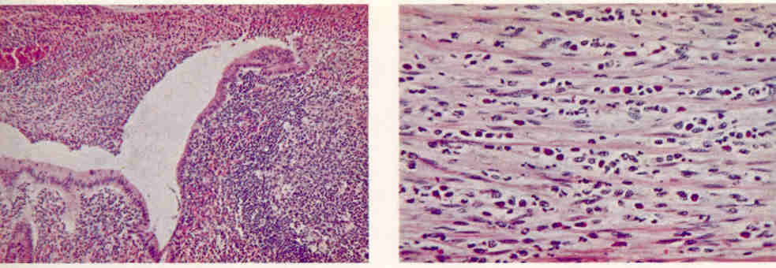
Acute appendicitis - Microscopy
Note – Mucosal ulceration and acute inflammation.
Transmural inflammation (within the muscularis propria)

Slide 27
Acute appendicitis - complications
Generalized peritonitis - due to rupture
Periappendicular mass - localized.
Portal pyaemia Liver abscess.
Portal pyelophlebitis.
Mucocoele Pseudomyxoma peritonei.
Localized globular enlargement of the appendix with dilated lumen containing a large amount of mucous.

Slide 28
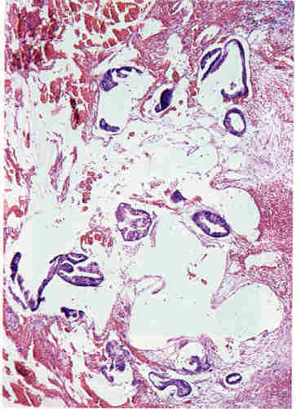
Pseudomyxoma peritonei
Other causes Occlusion of the lumen by tumour or faecolith Cystic fibrosis Mucoid hyperplasia Mucinous neoplasms. - Ovarian, colonic.

Slide 29
Appendix - Tumours
Adenocarcinoma
Mucin secreting tumours
  Benign
  Malignant - Includes signet ring cell carcinoma
Carcinoid tumours - commonest
Metastases - Breast, GIT, Female genital tract.

Slide 30
INFECTIVE ENTEROCOLITIS

Slide 31
Infective enterocolitis
Microbial causes of Diarrhoea
  Bacterial (invasive / toxogenic) Campylobacter jejunii
  E coli Salmonella * Shigella * Tuberculosis * Yersinia enterocolitica Vibrio cholera - (no pathological changes within the mucosa)

Slide 32
Infective enterocolitis
Viral (non toxogenic)
  Rotavirus
  Norwalk agent
Fungal
  Candida, mucormycoses
Protozoal and other parasites
  Entamoeba histolytica *
  Giardia lamblia - malabsorption
  Schistosoma mansoni
  Cryptosporidiosis, Strongyloides stercoralis. (in immunosupressed)

Slide 33
Infective enterocolitis
Mechanisms important in causing diarrhoea
  Capacity to invade.
  Enterotoxin production
  Adherence

Slide 34
Salmonellosis
Salmonella food poisoning Fever abdominal pain and vomiting - ACUTE onset.
Paratyphoid fever - milder form of typhoid fever.
Typhoid fever. - Salmonella typhi.

Slide 35
Typhoid fever
Incubation period - 7 - 14 days.
Salmonella typhi - gram negative rod.
Clinical features - Progressive rise in fever (step ladder rise) Skin rash - rose red spots. Headache Doughy abdomen

Slide 36
Typhoid fever
Macroscopy – Ovoid ulcers longitudinal and parallel to the long axis of the ileum.
(Corresponding to the Peyer’s patches)
Microscopy – Infiltration by lymphocytes and macrophages. Neutrophils absent. Typhoid nodules – collections of histiocytes with necrosis.
Recovery complete. Ulcer heals without stenosis.

Slide 37
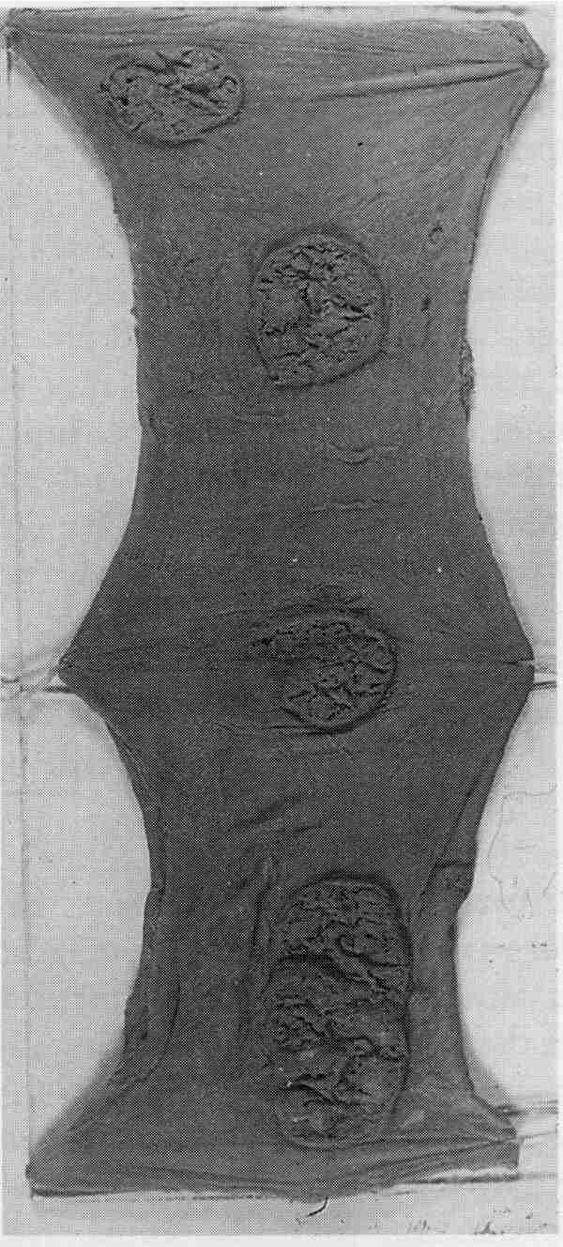
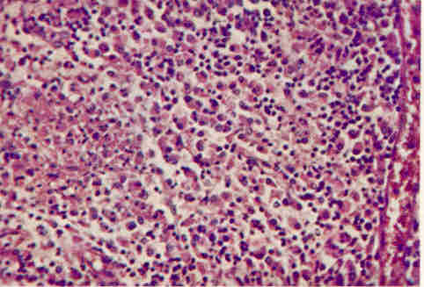
Microscopy – Histiocytic collections
Macroscopy

Slide 38
Typhoid fever
Complications – Carrier state Perforation Haemorrhage Peritonitis
Investigations - blood culture Urine culture Stools culture Widal test.

Slide 39
Shigella infection (Bacillary dysentry)
Shigella sonnei, flexneri, shiga – Gram negative rods.
Macroscopy –
  Pronounced mucosal odema congestion & focal erosion
  Irregular ragged ulceration (non – discrete) if severe.
Microscopy –
  Mucosal acute inflammation.
  Cryptitis and crypt abscess formation if severe.
  No crypt distortion.

Slide 40
Tuberculosis
Primary complex – ingestion of infected milk. (Bovine TB)
Lymph nodes prominent (Tabes mesentrica) – primary lesion inconspicuous. Peritoneal disease from mesentric lymph nodes prominent.

Slide 41
Tuberculosis
Secondary – from infective sputum.
Macroscopy –
  Transversly disposed ulcers therefore stricture formation with healing.
  Small nodules in the serosa.
Microscopy – Granuloma
Hyperplastic ileocaecal Tuberculosis Causing intestinal obstruction. RIF mass – DD: Carcinoma.

Slide 42
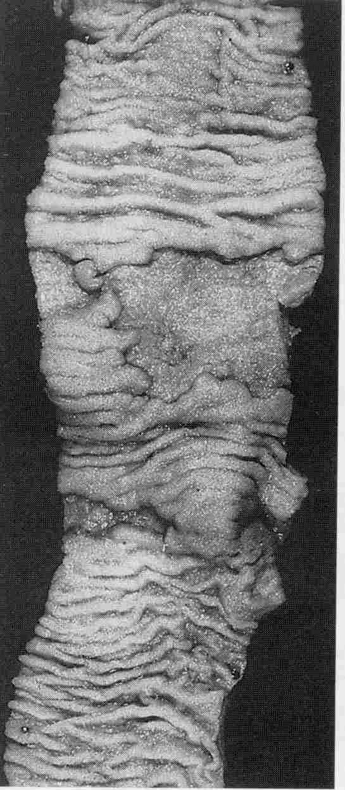
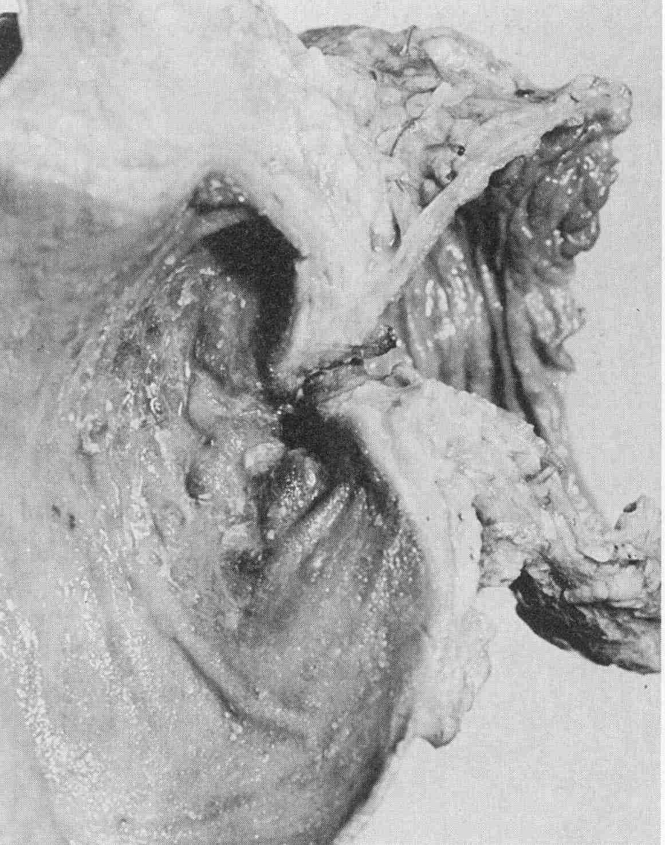
Transverse ulcers in TB
Hyperplastic TB – Ileocaecal region

Slide 43
Entamoeba histolytica - Amoebiosis
Asymptomatic
Amoebic colitis – loose stools.
Amoebic dysentry
Amoeboma / Amoebic pseudotumour-
  Rare.
  Large mass of granulation tissue which may obstruct the lumen.

Slide 44
Amoebic dysentry
Clinical features – Blood and mucous diarrhoea, Abdominal pain.
Sites – mainly caecum and Sigmoid colon. Rarely ileum and Appendix.
Macroscopy –
  Ulceration with intervening areas of normal mucosa.
Microscopy –
  Flask shaped ulcer ( on cross section) with overhanging edges.
  Plasma cells macrophages and “N” with amoebae at the advancing edge of the ulcer.

Slide 45
Assignment
How would you differentiate between Amoebic and Bacillary dysentry ?
  Clinical signs and symptoms.
  Bacteriological
  Stools
  Endoscopy – macroscopy microscopy.

Slide 46
Necrotizing enterocolitis.
Acute necrotizing inflammation of the colon.
Infants >3 months – preterm / Low BW.
with the start of oral / formula feeds
Symptoms –
Abdominal distress, Tenderness, diarrhoea, GI bleeds.
Affects mainly the ileum, Caecum and Ascending colon.

Slide 47
Acute necrotizing enterocolitis
Microscopy –
  Mucosal oedema, haemorrhage necrosis.
  Pseudomembrane formation.
Complications
  Immediate – Perforation, shock, Gangrene, Sepsis.
  Late – Malabsorption, Stricture, Recurrence, Short bowel syndrome (Ileal resection)

Slide 48
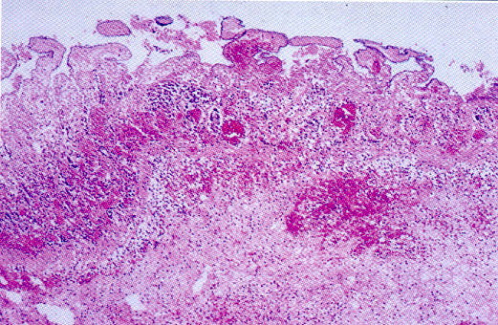
Necrosis & haemorrhage of the bowel wall

Slide 49
Yersiniosis
Appendicitis like syndrome – includes inflammation of the appendix with acute mesentric adenitis.
Microscopy – irregular area of suppuration surrounded by epethelioid histiocytes and langhan giant cells. – stellate necrotizing granulomatous suppuration.

Slide 50
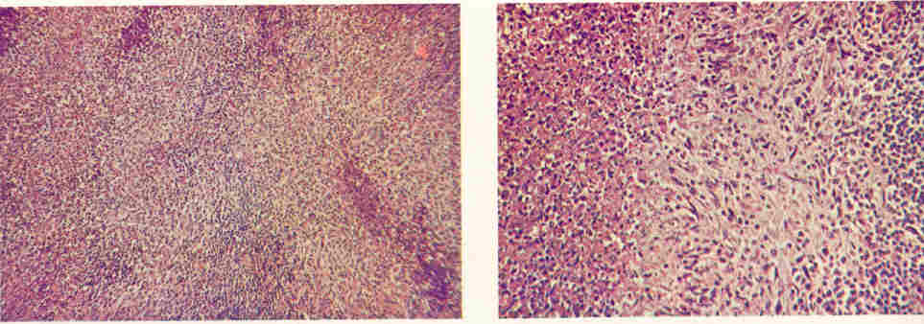
Stellate necrotizing granulomatous inflammation

Slide 51
Campylobacter infection
Diarrhoeal illness with acute pain = Acute appendicitis.
Acute colitis.
Prolonged duration may sometimes resemble IBD sometimes even microscopically.

Slide 52
Non bacterial enterocolitis.
Viral
Frank necrosis and ulceration of the mucosa not observed.
Inflammatory infitrate (PML and monocytes in the lamina propria)

